Slide 1
Data Structures
&
Algorithms
Prof. Ravi Prakash Gorthi
Jan – May 2017

Slide 2
Advanced Data Structures
Balanced Search Trees

Slide 3
Contents
Introduction
The 2-3 Trees Rules
The Advantage of 2-3 Trees
Searching For an Item in a 2-3 Tree
Inserting an Item into a 2-3 Tree
Removing an Item from a 2-3 Tree

Slide 4
INTRODUCTION
What Is a 2-3 Tree?
Definition: A 2-3 tree is a tree in which each internal node (non-leaf) has either 2 or 3 children, and all leaves are at the same level.

Slide 5
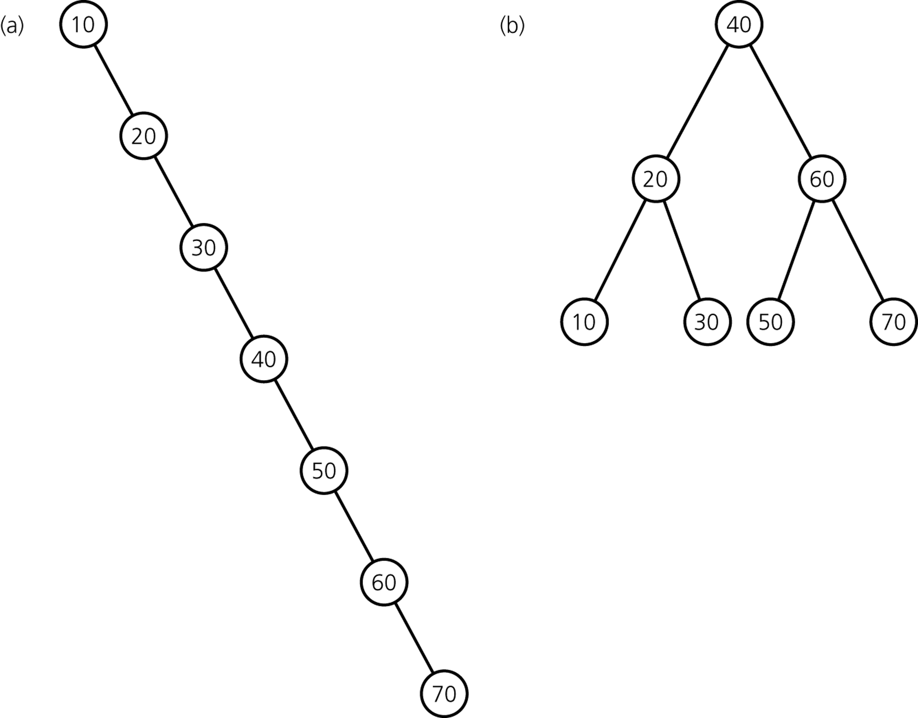
Why care about advanced implementations?
Same entries, different insertion sequence:
→ Not good! Would like to keep tree balanced.

Slide 6
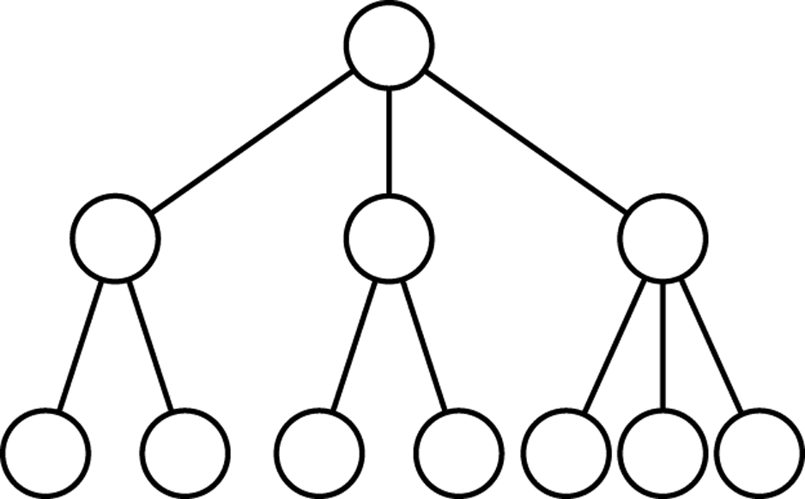
2-3 Trees
Features
each internal node has either 2 or 3 children
all leaves are at the same level

Slide 7
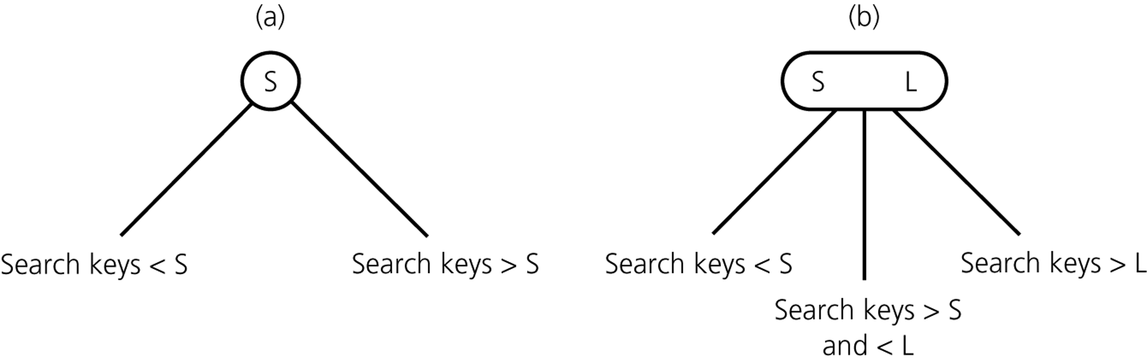
2-3 Trees with Ordered Nodes
2-node
3-node
leaf node can be either a 2-node or a 3-node

Slide 8
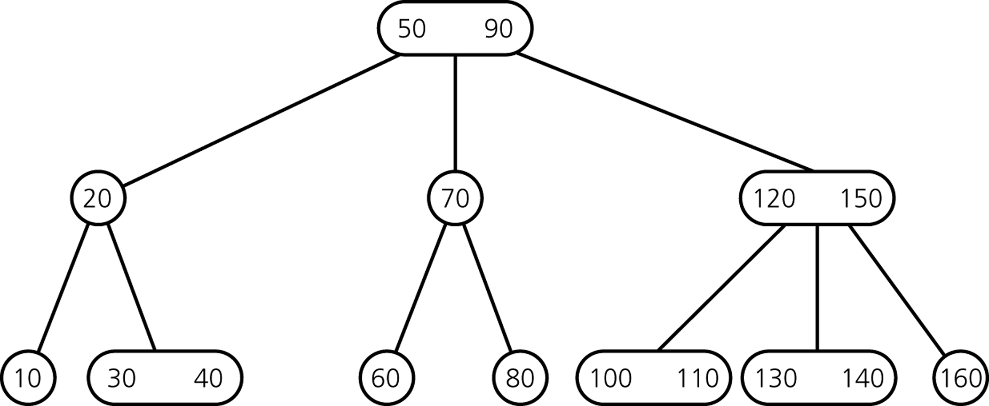
Example of 2-3 Tree
CSCI 3110

Slide 9
The Advantages of the 2-3 trees
Even though searching a 2-3 tree is not more efficient than searching a AVL tree, by allowing the node of a 2-3 tree to have three children, a 2-3 tree might be shorter than the shortest possible AVL tree.
Maintaining the balance of a 2-3 tree is relatively simple than maintaining the balance of a AVL tree .

Slide 10
Consider the two trees contain the same data items.
50
60
30
90
30
70 90
10
50
80
100
10 20
40
60
80
100
20
40
70
A balanced binary search tree
A 2-3 tree

Slide 11
Inserting into a 2-3 Tree
Perform a sequence of insertions on a 2-3 tree is more easilier to maintain the balance than in an AVL tree.
Example:

Slide 12
60
30
90
30
50
80
100
20
40
70
39
38
37
36
The binary search tree after a sequence of
insertions
35
34

Slide 13
37
34
50
30
35
39
70 90
10 20
36
38
40
60
80
100
2) The 2-3 tree after the same insertions.

Slide 14
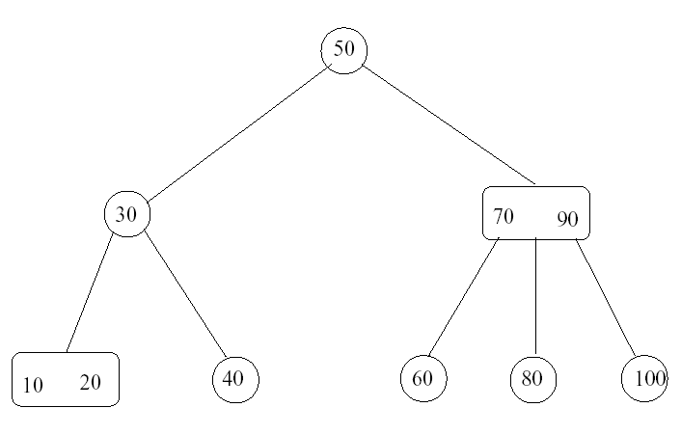
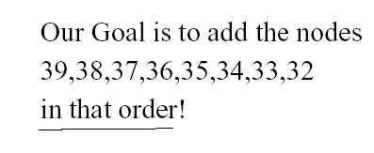

Slide 15
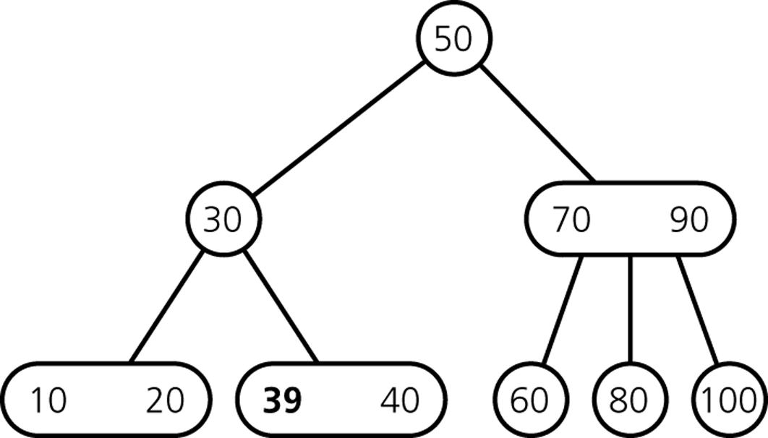
Inserting Items
Insert 39
CSCI 3110

Slide 16
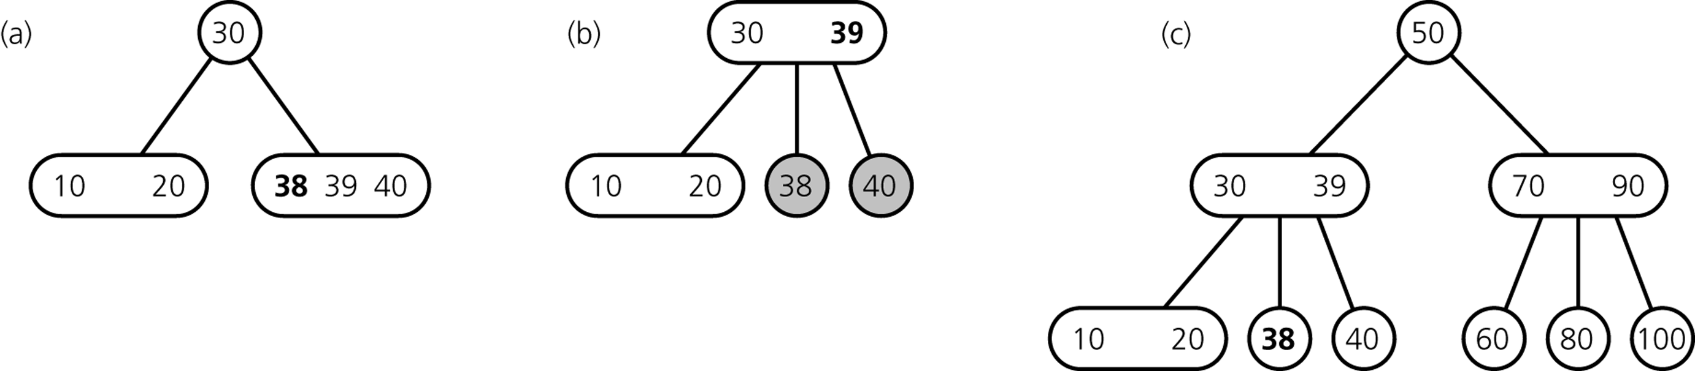
Inserting Items
Insert 38
divide leaf
and move middle
value up to parent
insert in leaf
result
CSCI 3110

Slide 17
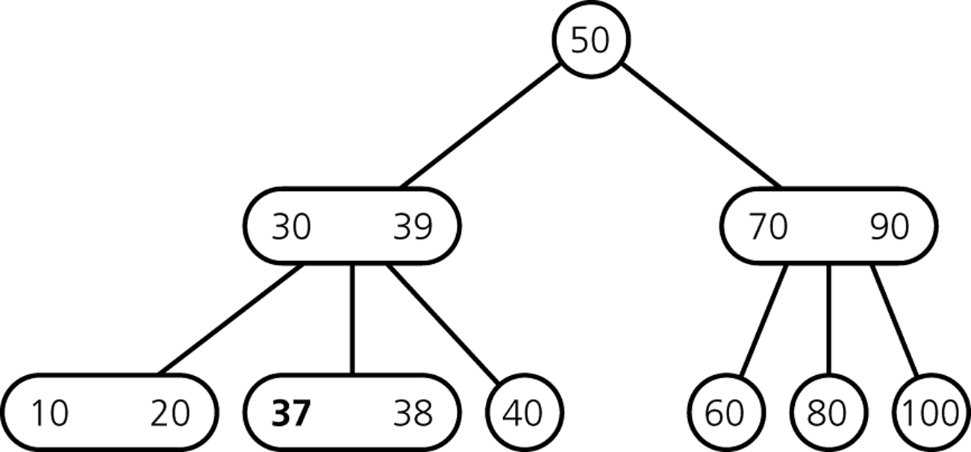
Inserting Items
Insert 37
CSCI 3110

Slide 18
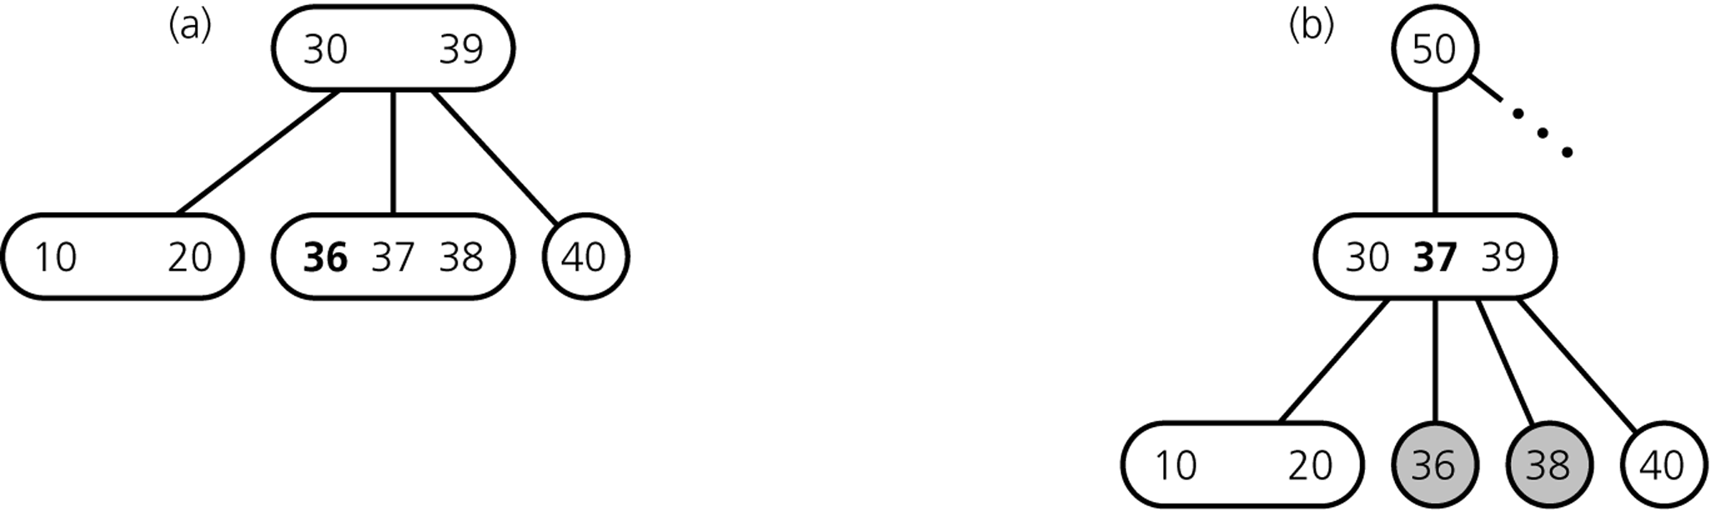
Inserting Items
Insert 36
divide leaf
and move middle
value up to parent
insert in leaf
overcrowded
node
CSCI 3110

Slide 19
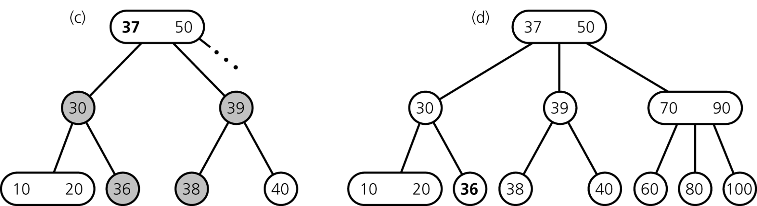
Inserting Items
... still inserting 36
divide overcrowded node,
move middle value up to parent,
attach children to smallest and largest
result
CSCI 3110

Slide 20
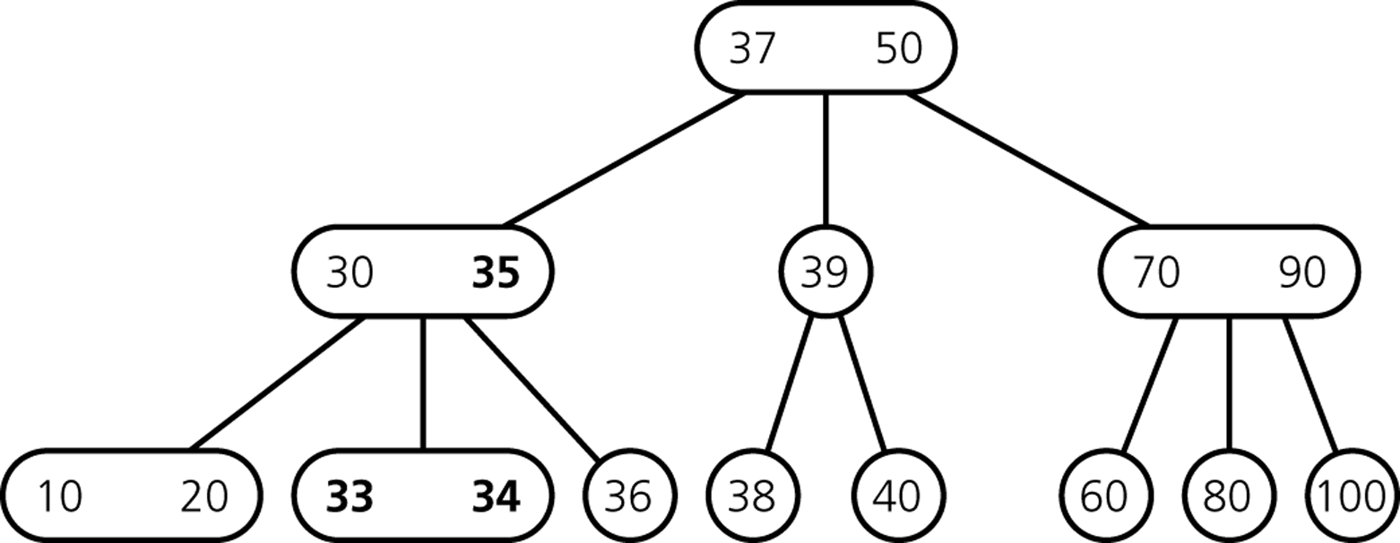
Inserting Items
After Insertion of 35, 34, 33
CSCI 3110

Slide 21
Inserting Items
How do we insert 32?
CSCI 3110

Slide 22
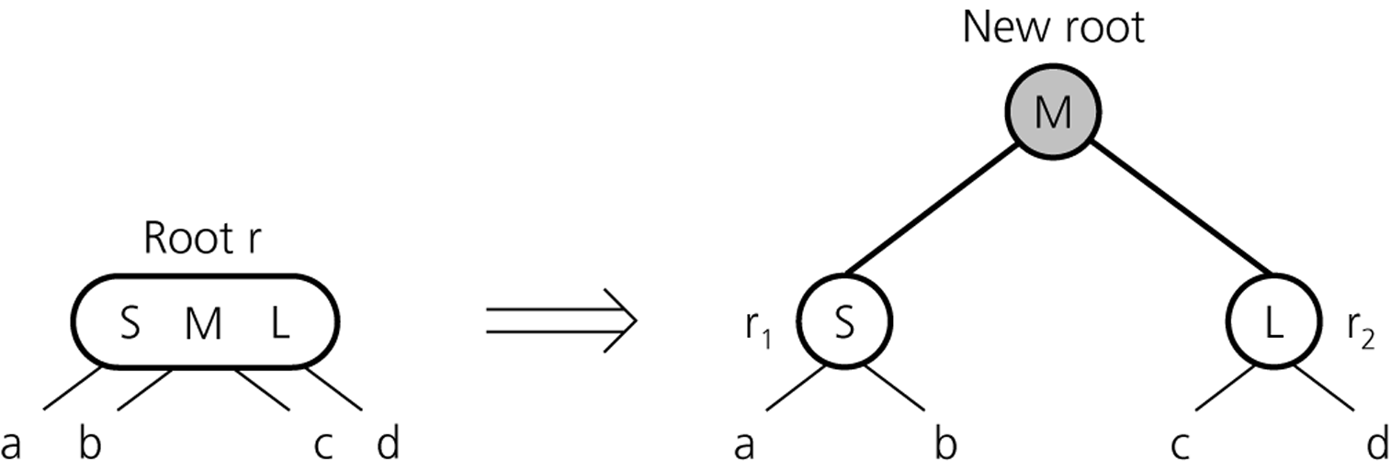
Inserting Items
creating a new root if necessary
tree grows at the root
CSCI 3110

Slide 23
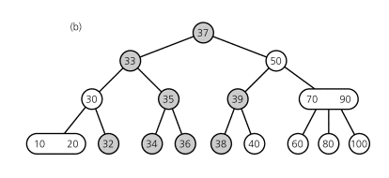
Inserting Items
Final Result
CSCI 3110

Slide 24
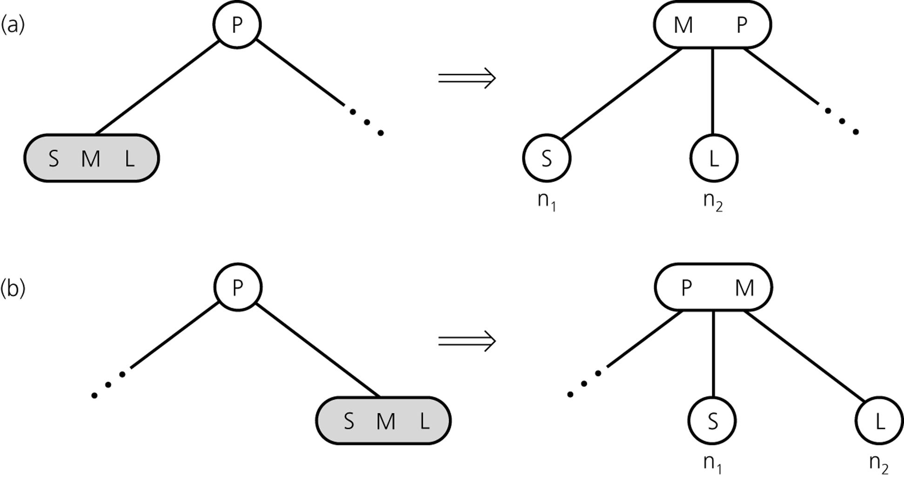
Inserting so far
CSCI 3110

Slide 25
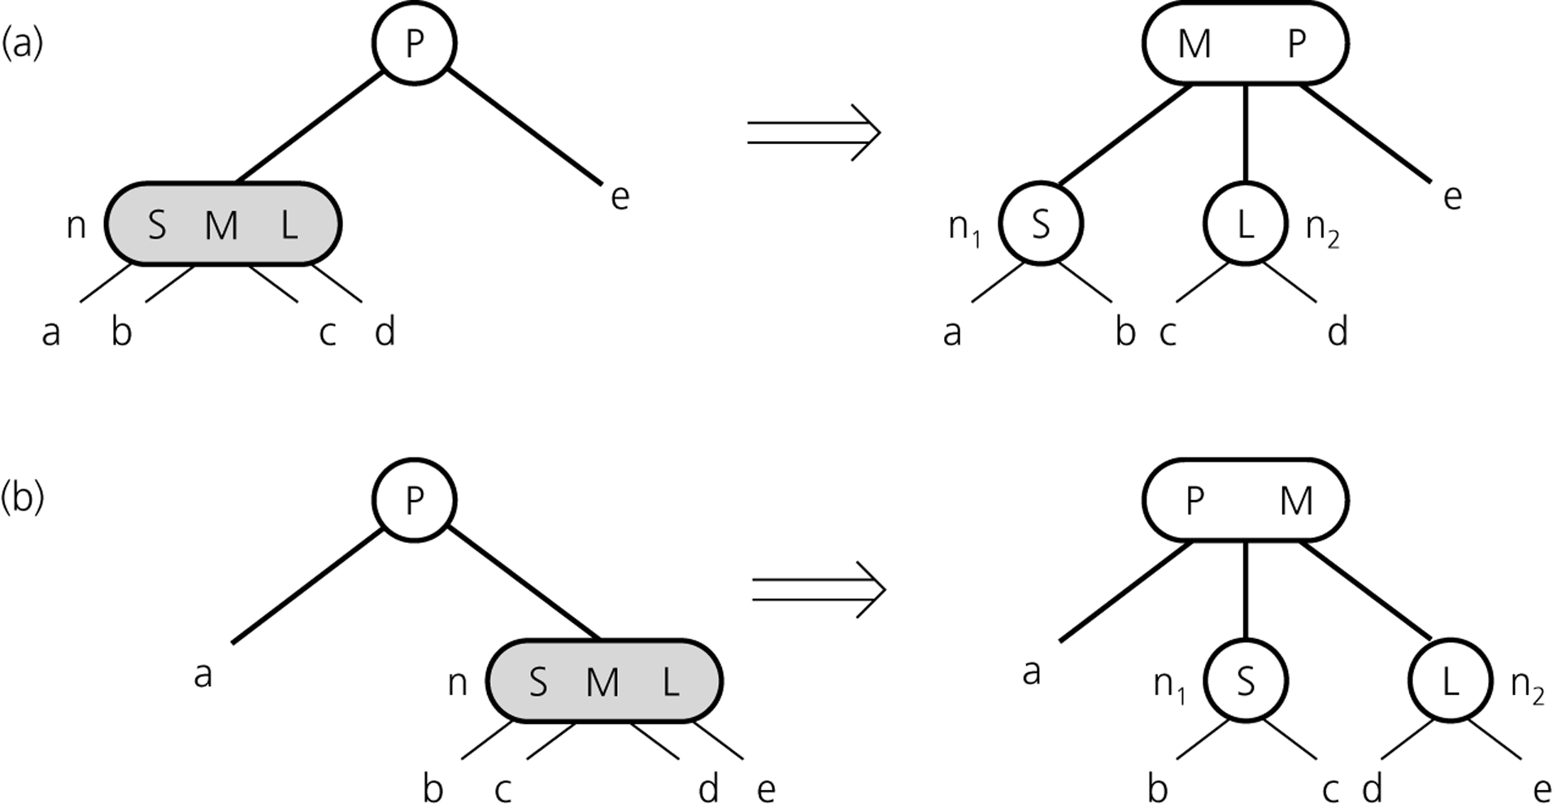
Inserting so far
CSCI 3110

Slide 26
2-3 Trees Insertion
To insert an item, say key, into a 2-3 tree
  Locate the leaf at which the search for key would terminate
  If leaf is null (only happens when root is null), add new root to tree with item
  If leaf has one item insert the new item key into the leaf
  If the leaf contains 2 items, split the leaf into 2 nodes n₁ and n₂
CSCI 3110

Slide 27
2-3 Trees Insertion
When an internal node would contain 3 items
  Split the node into two nodes
  Accommodate the node’s children
When the root contains three items
  Split the root into 2 nodes
  Create a new root node
  The tree grows in height
CSCI 3110

Slide 28
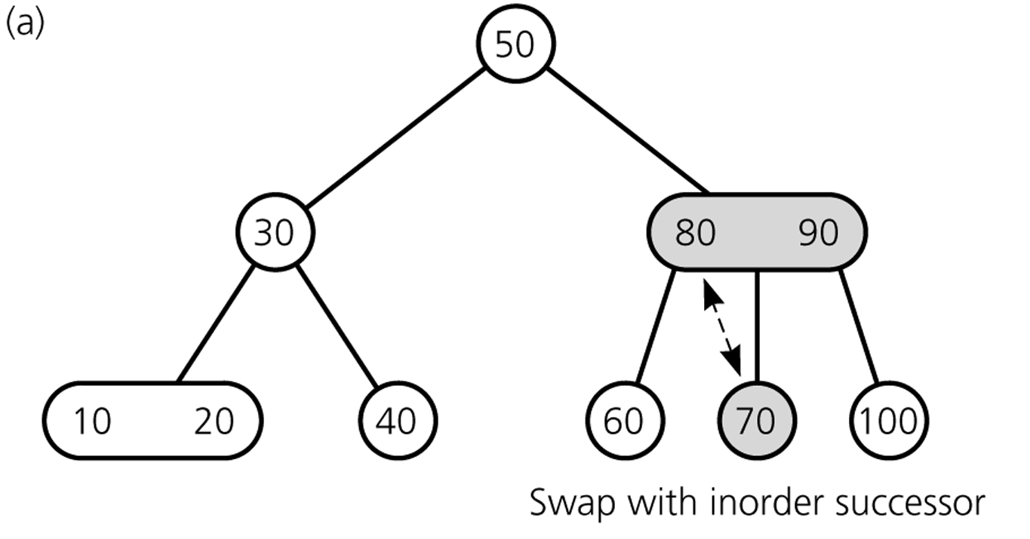
Deleting Items
Delete 70
70
80
CSCI 3110

Slide 29
Deleting Items
Deleting 70: swap 70 with inorder successor (80)
CSCI 3110

Slide 30
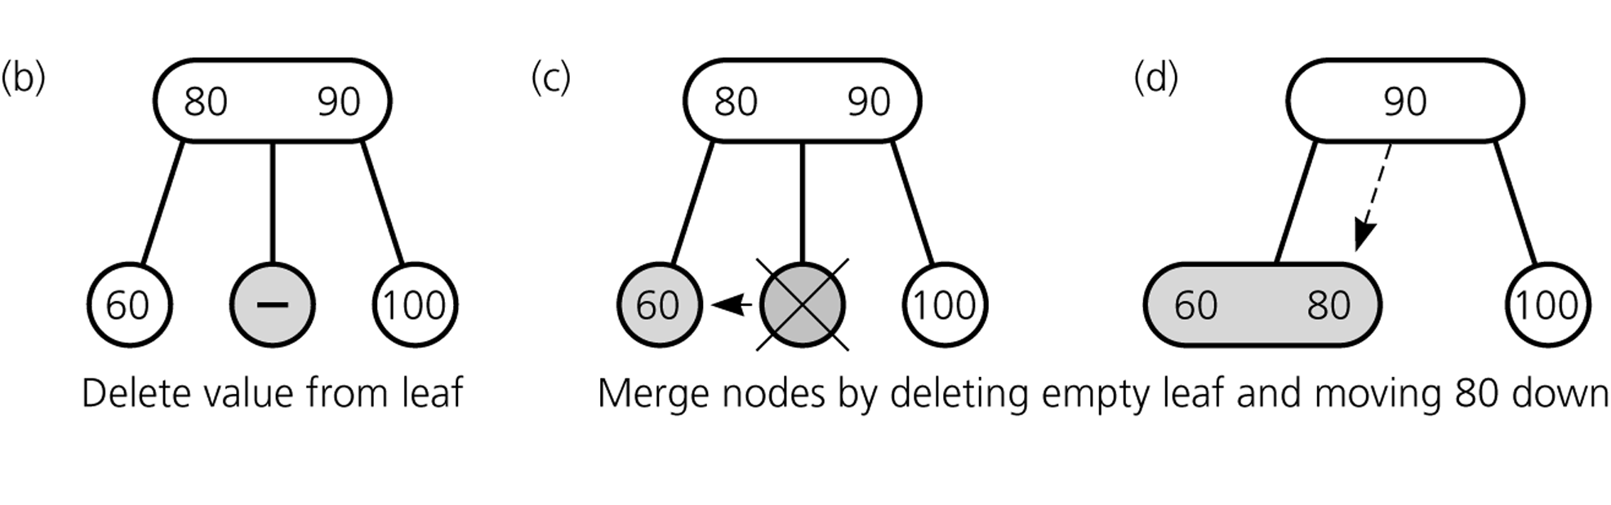
Deleting Items
Deleting 70: ... get rid of 70
CSCI 3110

Slide 31
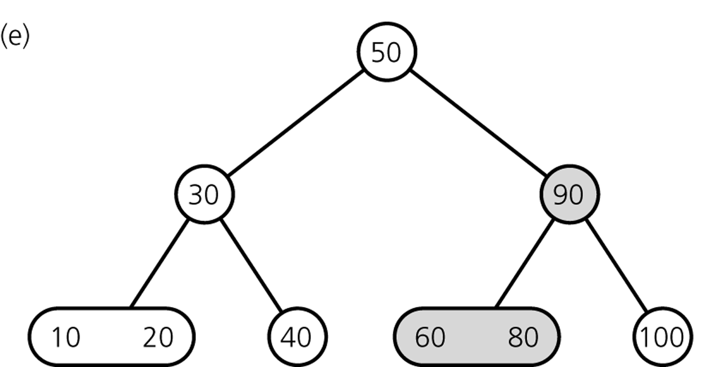
Deleting Items
Result
CSCI 3110

Slide 32
Deleting Items
Delete 100
CSCI 3110

Slide 33
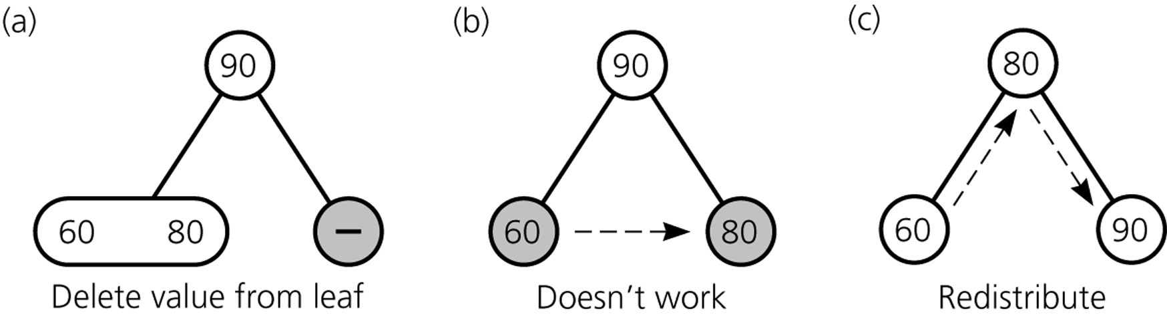
Deleting Items
Deleting 100
CSCI 3110

Slide 34
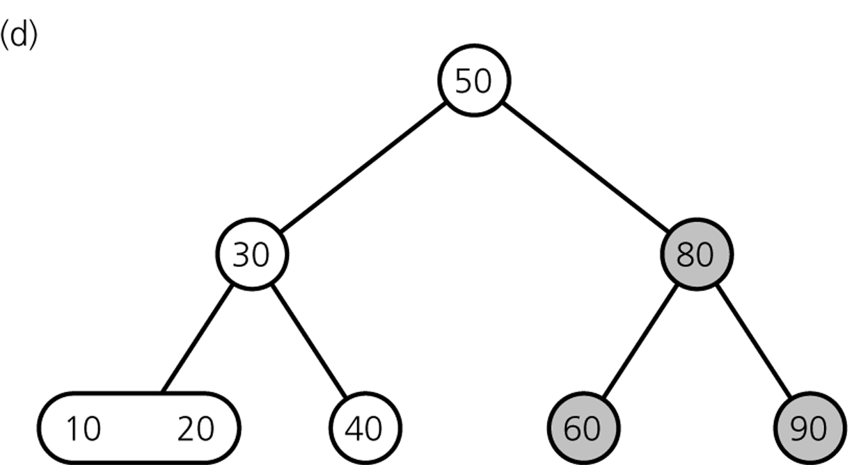
Deleting Items
Result
CSCI 3110

Slide 35
Deleting Items
Delete 80
CSCI 3110

Slide 36
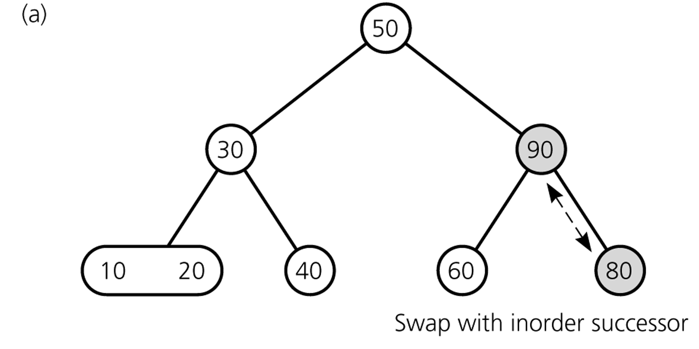
Deleting Items
Deleting 80 ...
CSCI 3110

Slide 37
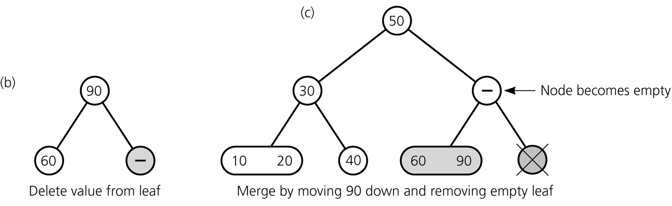
Deleting Items
Deleting 80 ...
CSCI 3110

Slide 38
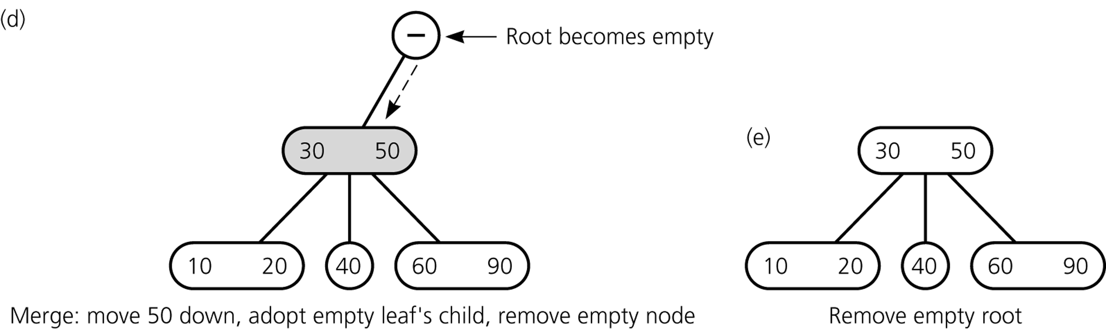
Deleting Items
Deleting 80 ...
CSCI 3110

Slide 39
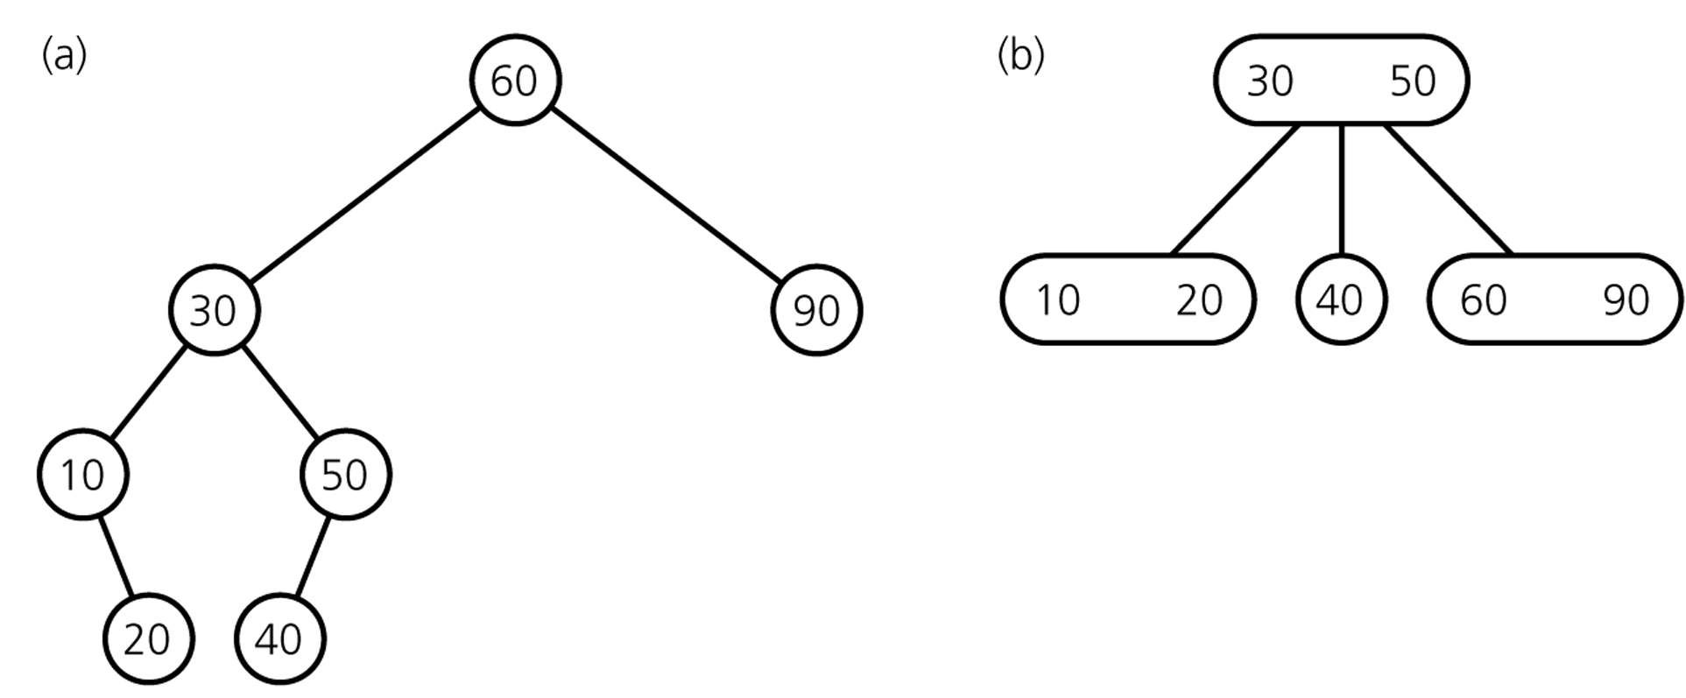
Deleting Items
Final Result
comparison with
binary search tree
CSCI 3110

Slide 40
Deletion Algorithm I
Deleting item I:
Locate node n, which contains item I (may be null if no item)
If node n is not a leaf → swap I with inorder successor
deletion always begins at a leaf
If leaf node n contains another item, just delete item I
else
try to redistribute nodes from siblings (see next slide)
if not possible, merge node (see next slide)
CSCI 3110

Slide 41
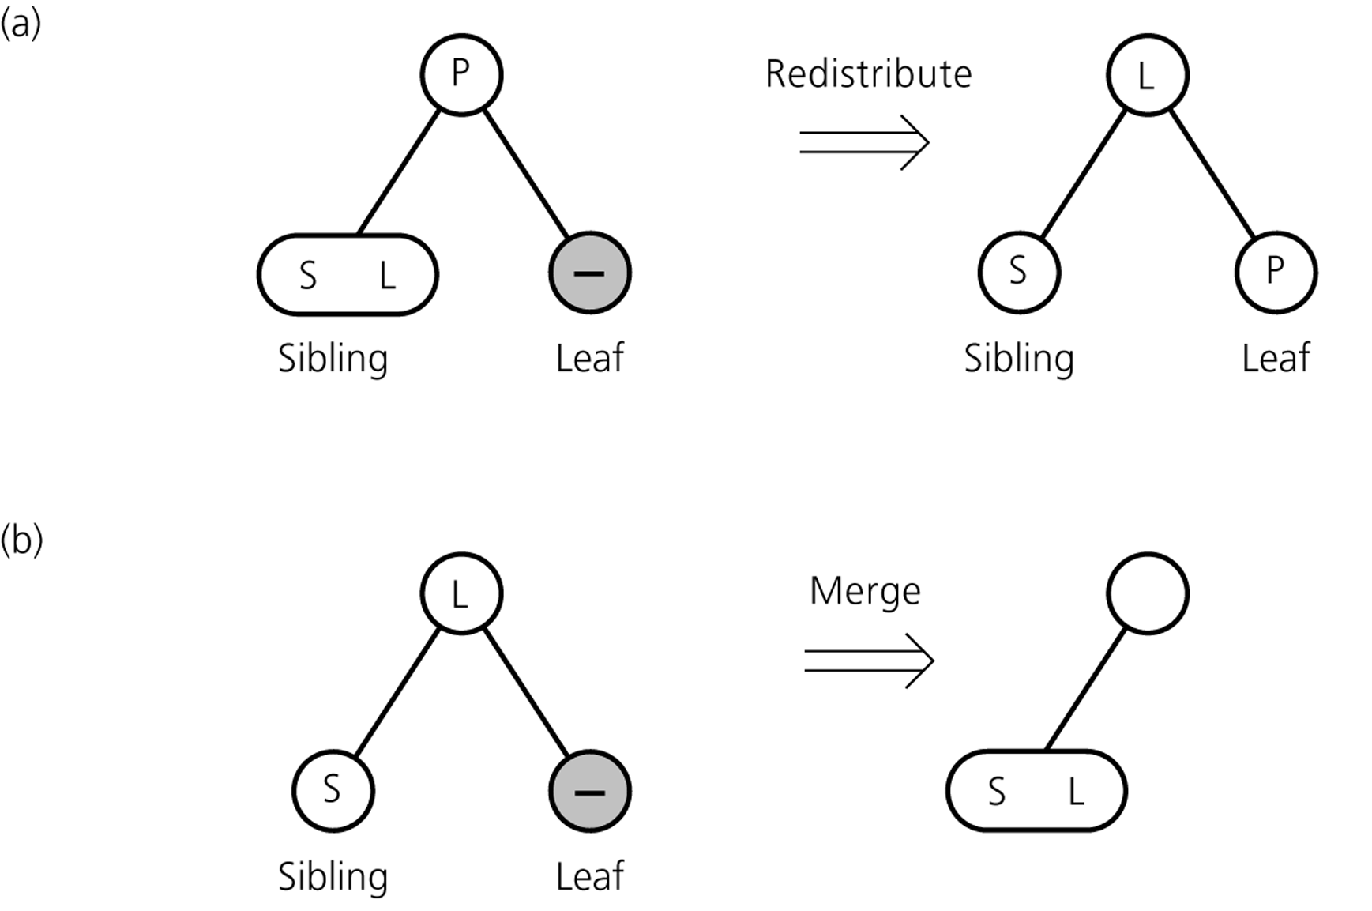
Deletion Algorithm II
Redistribution
A sibling has 2 items:
redistribute item
between siblings and
parent
Merging
No sibling has 2 items:
merge node
move item from parent
to sibling
CSCI 3110

Slide 42
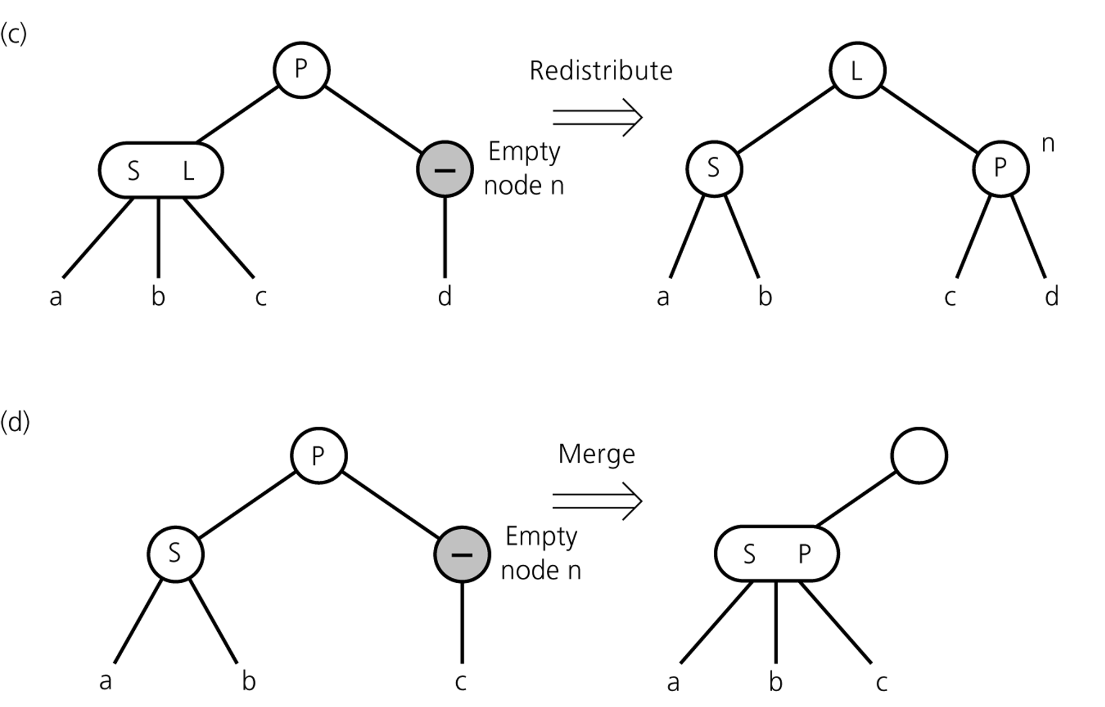
Deletion Algorithm III
Redistribution
Internal node n has no item left
redistribute
Merging
Redistribution not possible:
merge node
move item from parent
to sibling
adopt child of n
If n's parent ends up without item, apply process recursively
CSCI 3110

Slide 43
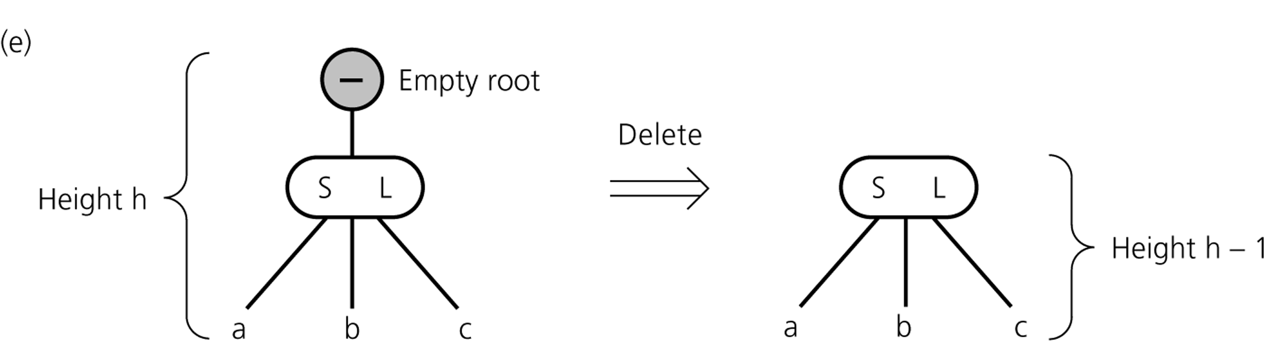
Deletion Algorithm IV
If merging process reaches the root and root is without item
→ delete root
CSCI 3110

Slide 44
Operations of 2-3 Trees
all operations have time complexity of log n
CSCI 3110

